Slide 1
FLIGHT FARE PREDICTION
BY -
SAKSHI SHREYA 1905632
MIKITA MAJUMDAR 1905327
RACHEET PRADHAN 1905112
ABHIJIT ROUT 1905074

Slide 2
INTRODUCTION
Our project is flight fare prediction. Which helps user to search for flights on their desirable dates also can look into the fare for that day.
Nowadays people travel a lot and currently using flight for their travel.
This project is written in Python and deployed using interface i.e. flask .
This project can be used to predict the pricing of the flight fare on the departure date as well as the arrival date.
Even also its shows if their are any breaks in between the travel journey.

Slide 3
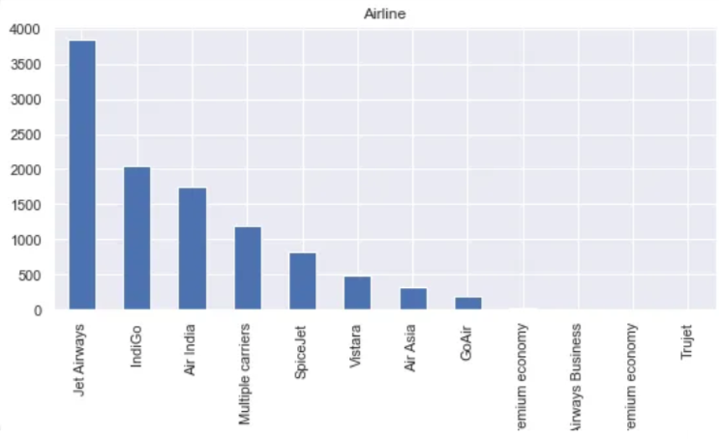
FLIGHT FARE DATASET
The dataset that we have used for our project is very useful in order to find the cheapest flight at the correct timing.
By using the dataset we can also see the no of stoppages or favorable airlines.
The goal of using this dataset is to predict the prices between various cities on the basis of departure and arrival date .
By using this dataset we aim to build a model which predicts the prices of the flights using various input features.
Dataset consists of 10 columns:
Airline(favorable airline company ),date of journey, source,destination,route,department time, arrival time,duration,no of stops(if any break),price.

Slide 4
PREREQUISITES
Python
High-level, general-purpose programming language
Used for build websites and software, automate tasks, and conduct data analysis
Numpy
- Library for Python supporting matrices and mathematical functions
- Used for working with arrays. It also has functions for working in domain of linear algebra, fourier
transform, and matrices.
Pandas
- Python programming language for data manipulation and built on numpy package
- Used for data manipulation and analysis
Matplotlib
- A plotting library simple visualization
- Used for creating static, animated, and interactive visualizations in python
Flask
- Micro web framework written in Python.
- Used for developing web applications in Python
Scikit Learn
- It features various machine learning algorithms and evaluation metrics
- Used for - Algorithmic decision-making method

Slide 5
ML MODELS
Supervised
a. Regression ( Logistic and Linear) : Estimates relationships among variables , finding key patterns in large and diverse datasets.
b. KNN: To create coordinates for each object in a n-dimensional space.
c. Decision Tree: Determine what category an input falls into by traversing the leaf’s and nodes of a tree.
d. Random Forest : Combines the output of many decision trees to reach a single result.
Unsupervised
a. K-Means: This is used to find the similarities between objects and groups them into K different clusters.
b. Hierarchical Clustering: It builds a tree of nested clusters without having to
specify the number of clusters.

Slide 6
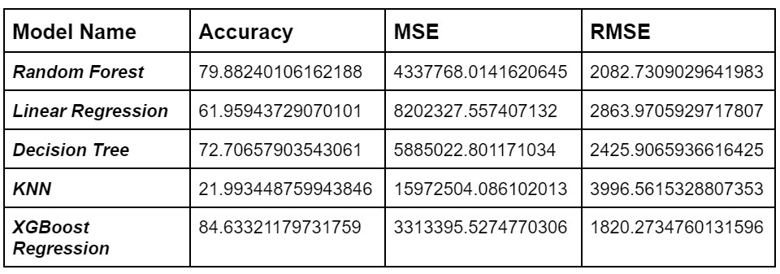
In this project , we have used 5 different machine learning models:
Linear Regression
Decision Tree
Random Forest
KNN Classifier
XGBoost
Comparison of accuracy b/w models:
From the table we can see that , XGBoost
Regression model provides the best accuracy .
This model has the best combination of prediction
performance and processing time compared to
others.
It has the capacity to do parallel computation on a
single machine as it is both linear model solver and
tree learning algorithm.

Slide 7
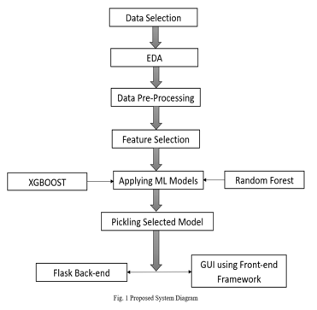
IMPLEMENTATION
In this project we followed these steps:
Data Exploration
Cleaning of data
Feature selection
Encoding
Deployment

Slide 8
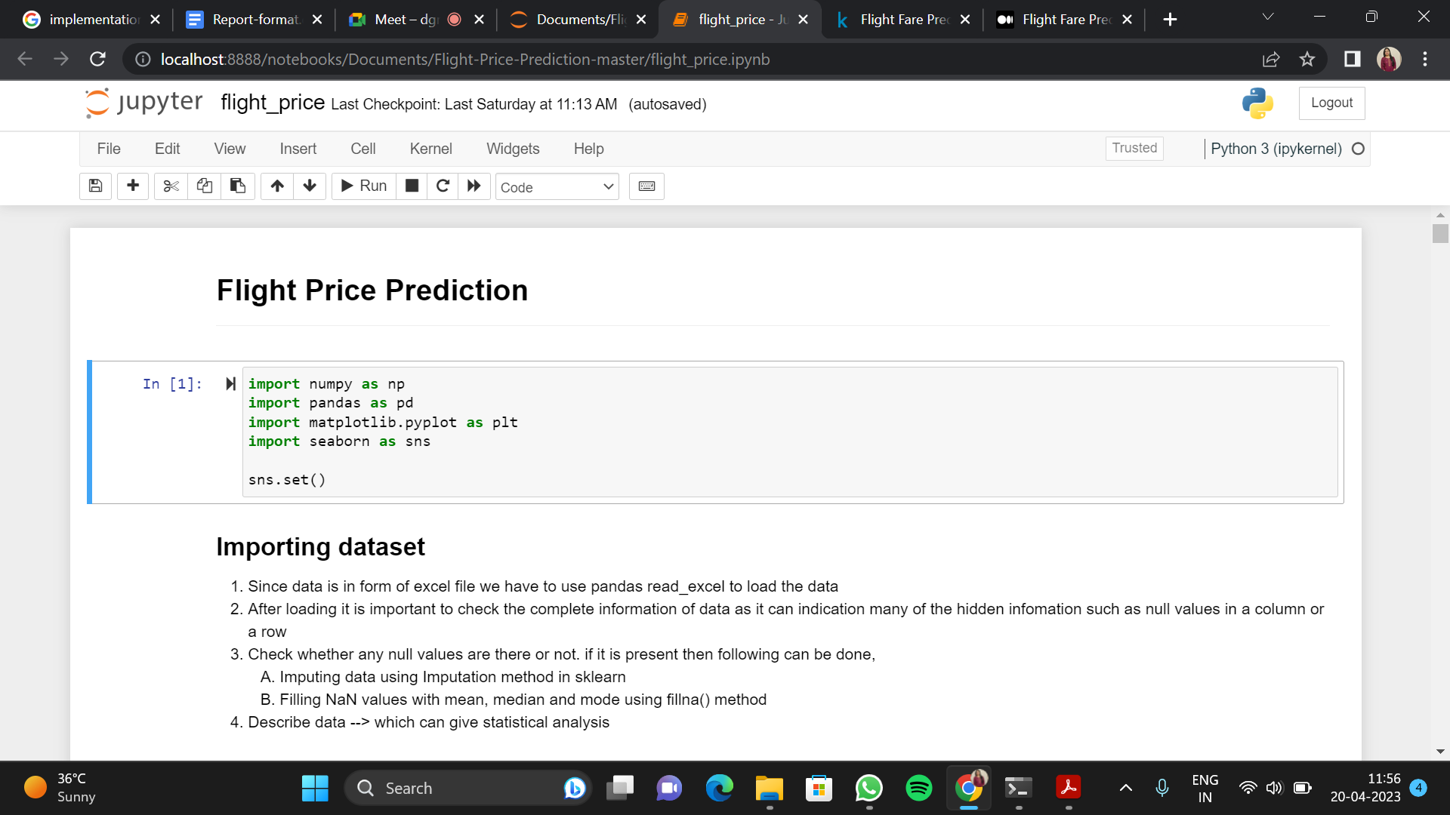
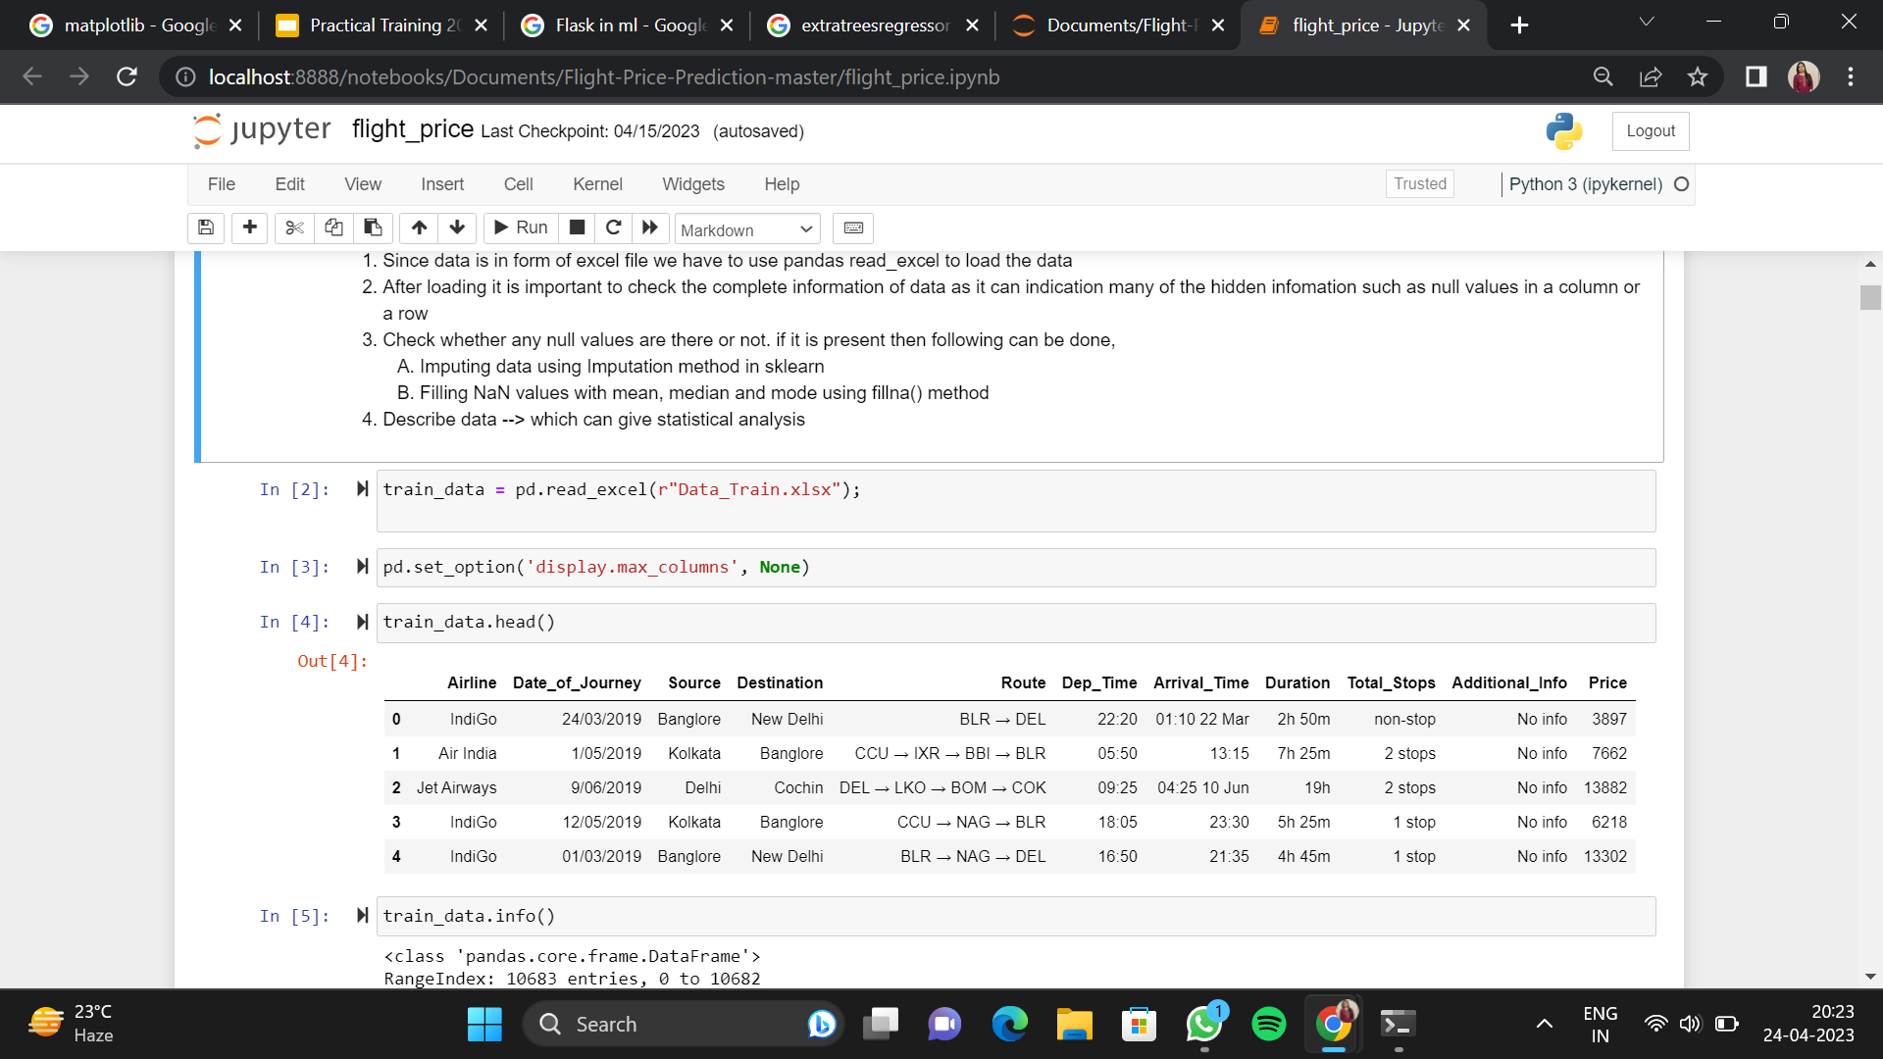
Importing dependencies
First up I’ve imported the python packages / libraries
that I’ve used for this app.
We have used matplotlib for data visualisation.
Data Preprocessing :
Before modelling , we will preprocess the dataset.
We have removed the null values amd dropped
the columns of no use and finally cleaned data
set is received which is splitted in two parts
i.e. train and test.

Slide 9
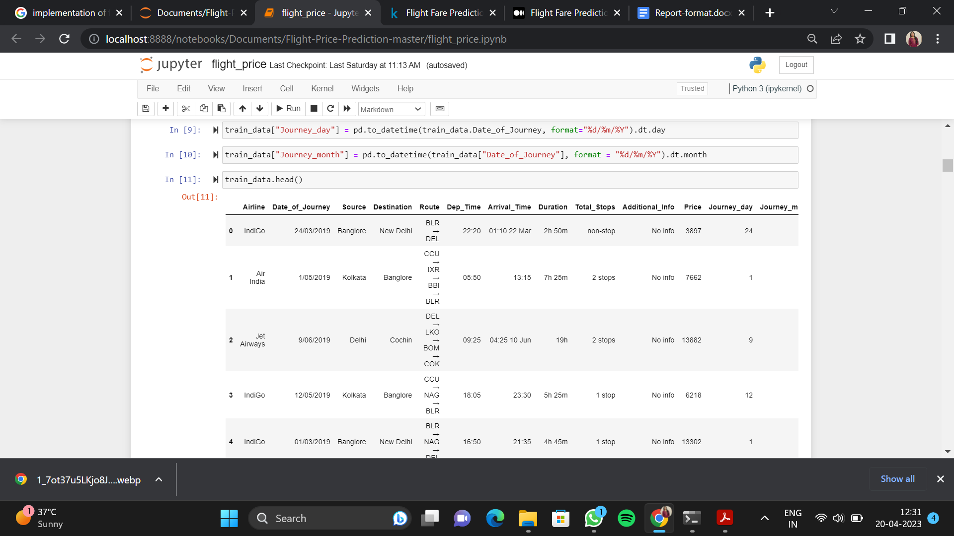
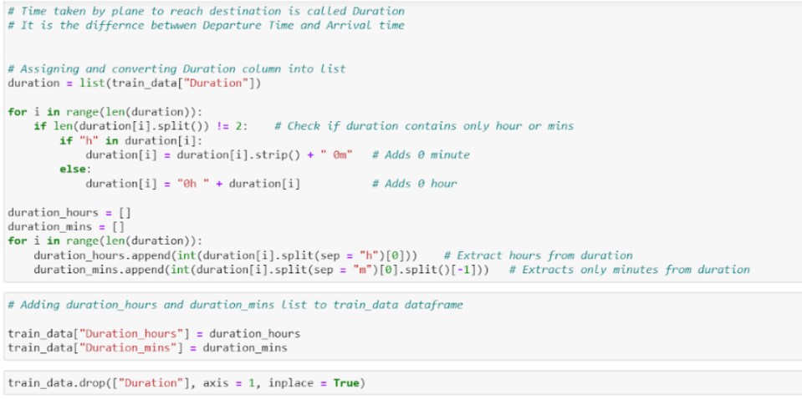
EDA
We have to convert the datatype of ‘Date_of_Journey’
which is object into timestamp so as to use this column properly for prediction. For this we require pandas “to_determine” to convert object data type to datetime dtype.
Calculating the time taken by plane to reach the destination .

Slide 10
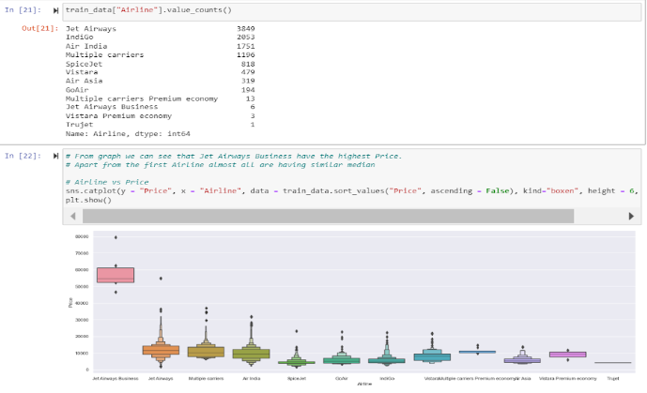
Some of the categorical data are :
Nominal data : Data is not in the order.
Ordinal data : Data are in order.
Since Airline column has 12 unique values it is nominal categorical data and there is less cardinality so we will
perform one hot encoding.
Deployment:
After applying different models and finding the best one , we have deployed the web page using flask and predicted the flight fare.

Slide 11
UI AND RESULT ANALYSIS
Result analysis for flight price prediction involves evaluating the performance of the predictive model and identifying areas for improvement.
User inputs:
Departure airport
Arrival airport
Travel dates
Preferred airlines
Flight type
The more specific the user inputs are the more accurate the flight price prediction is likely to be. For example providing exact travel dates and preferred airlines can help the predictive model make more precise predictions. On the other hand if the user is flexible with their travel dates the predictive model may be able to find lower priced flights that fall outside of the user’s initial search parameters.
The user input parameters are: Departure Date : 25.04.2023 15:00, Arrival Date : 25.04.2023 17:30, Source : Mumbai, Destination : Delhi< Stoppage : Non Stop < Airline to travel : Vistara.
Hence the price predicted is Rs. 5166.16

Slide 12
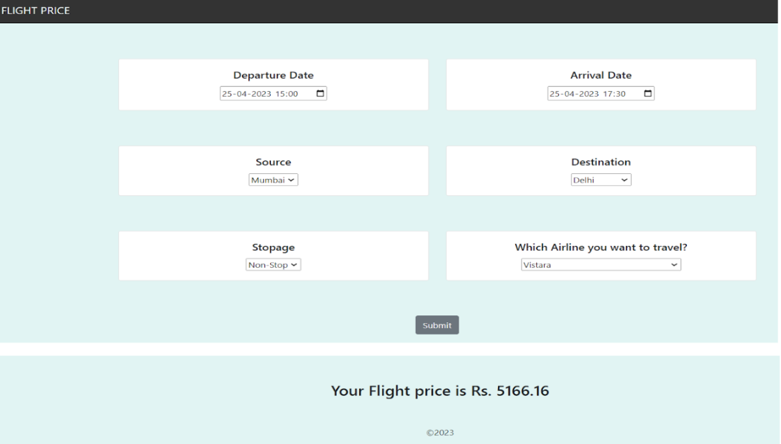

Slide 13
CONCLUSION AND FUTURE SCOPE
In conclusion, a flight price prediction project can be a useful tool for travelers who want to plan their trips and save money on airfare. By analyzing historical data and using machine learning algorithms, it is possible to build a model that can accurately predict the price of a flight at a given time. However, it is important to keep in mind that there are many factors that can affect flight prices, such as seasonality, demand, and airline policies, which may not be captured by the model. Therefore, it is always recommended to use the predictions as a guide and to also consider other factors when making a decision on purchasing a flight ticket.
There are several potential future scopes for a flight price prediction project:
Multi-airline prediction
Real-time predictions
Personalized recommendations
Integration with travel planning apps

Slide 14
THANK YOU

